Slide 1

New York Times Data Analysis Using HIVE
CIS5200:03 | Project Group 3
Submitted By:
Divya Pakhale
Sanchita Gawand
Siddhi Udani
Tanvi Gawade
Submitted To: Prof Jongwook Woo

Slide 2

INTRODUCTION
Large number of readers
Shapes public opinion
Outlook on current affairs
Sets the tone of the public discourse
Comments sections give insights to readers’ opinions on the subject matter of the articles

Slide 3
GOALS
Analyzing sentiments of people based on positive negative comments
Analyzing the recommendation's, news desk, reply, document type counts
Analyzing most talked topic
Analyzing the highest recommendations based on user location

Slide 4

About Dataset
Dataset URL: https://www.kaggle.com/aashita/nyt-comment
Comments, Articles | 2017,2018 | Jan-May
Columns: Reply count, Comments, Month, User location, Article Word Count
Dataset Size: 1.5 GB

Slide 5

TECHNICAL SPECIFICATION
Cluster version: Oracle Big Data Compute Edition
Cluster number of nodes: 5 nodes
Memory size(CPU speed): 2.20 GHz
HDFS Capacity: 147 GB
Storage: 678 GB

Slide 6
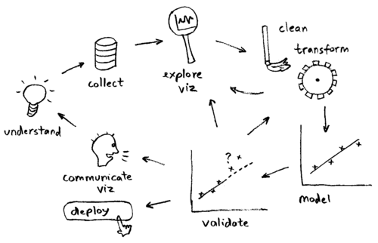









FLOWCHART
Dataset Source
New York Times
Downloaded csv files
Data Cleaning
Store and Processes Data
Query
Visualize

Slide 7

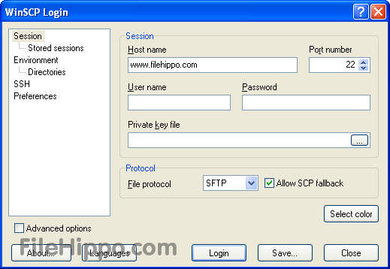
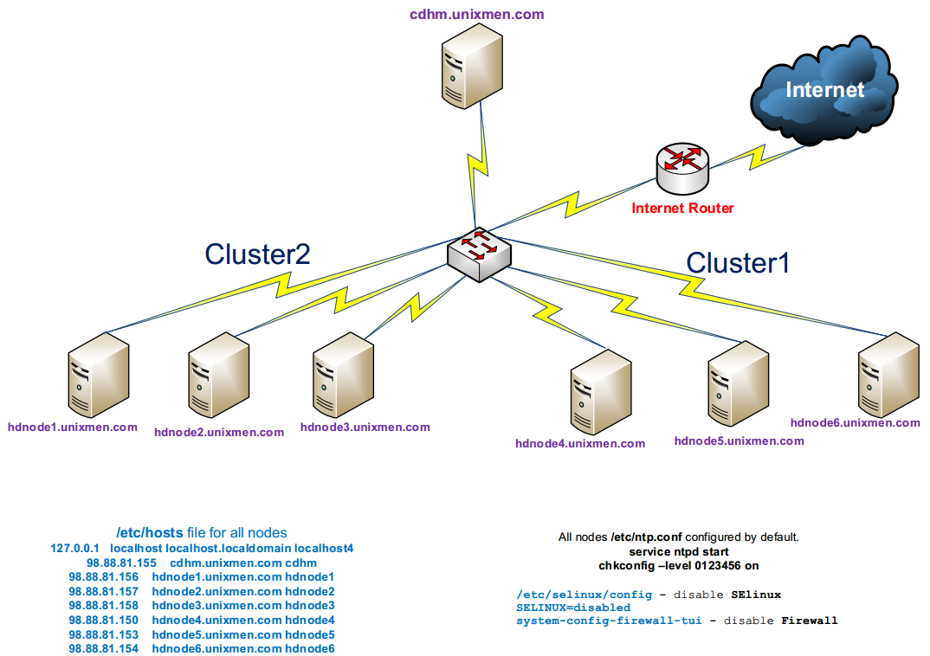

ARCHITECTURE CHARTS
wget –O https://raw.githubusercontent.com/tanvigawade/April2017/master/ArticleYear2017.txt
wget https://raw.githubusercontent.com/tanvigawade/April2017/master/ArticleYear2018.txt
winscp commentyear2016
Winscp comment year 2017
ssh tgawade@129.150.206.199
Oracle Big Data Compute Edition

Slide 8

Link: https://github.com/tanvigawade/Project5200_Group3.git

Slide 9
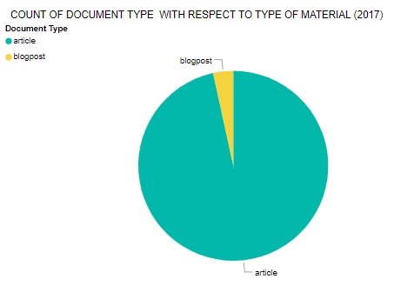
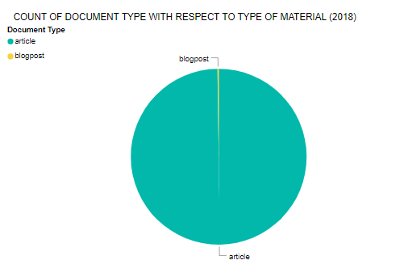
COUNT OF DOCUMENT TYPE/ TYPE OF MATERIAL
Maximum: Article: 4410, 4758
Minimum: Blogpost: 156, 11

Slide 10
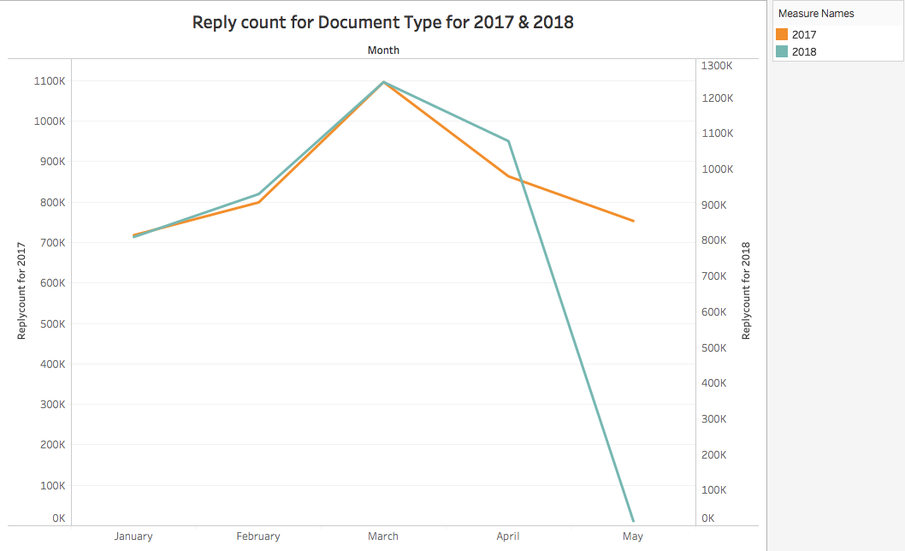
REPLY COUNT FOR DOCUMENT TYPE MONTH WISE
Highest: March:
1,096,568
Least: May:
753,825

Slide 11
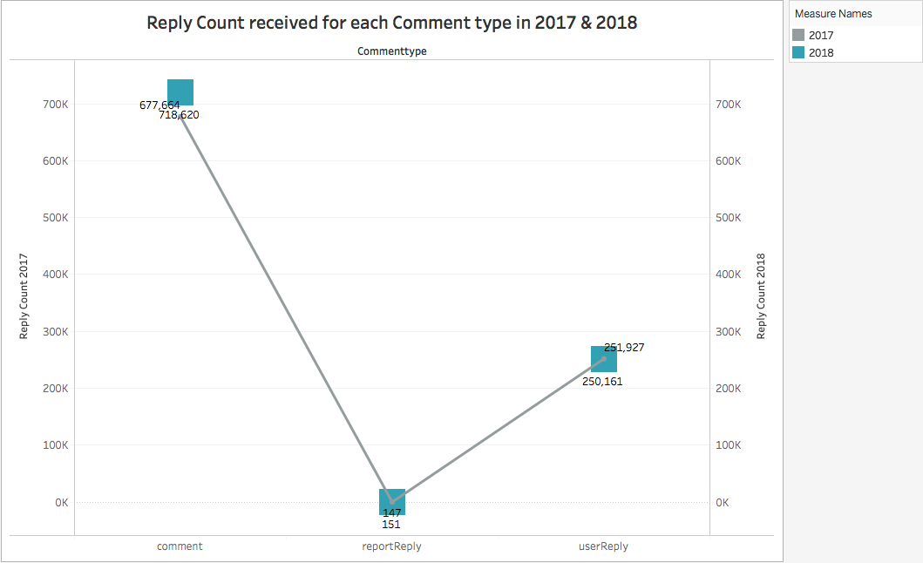
REPLY COUNT FOR EACH COMMENT TYPE
Year 2017/2018:
Comment
User Reply
Report Reply
Decrease in 2018

Slide 12

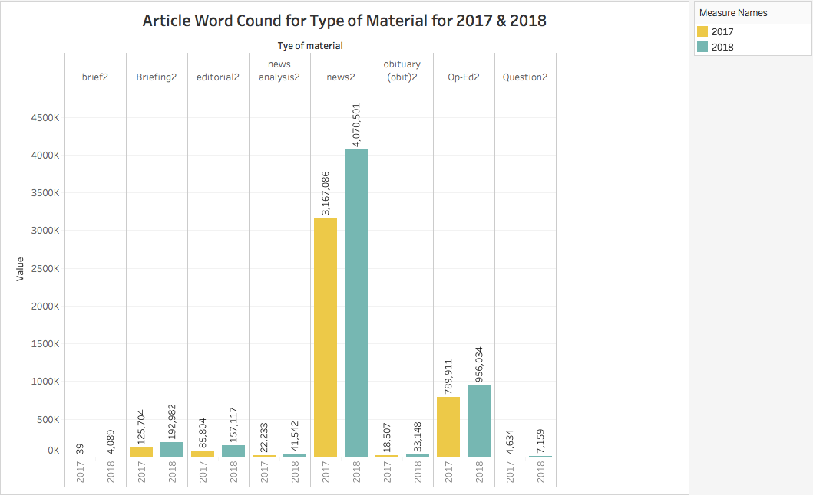
FREQUENCY OF TYPE OF MATERIAL WRT ARTICLE WORD COUNT
Year 2017
Low: Brief
High: News
Year 2018
Low: Brief
High: News

Slide 13
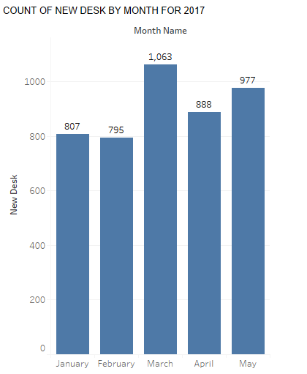
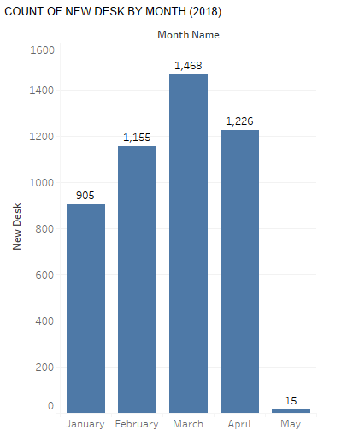
COUNT OF NEW DESK MONTH WISE

Slide 14
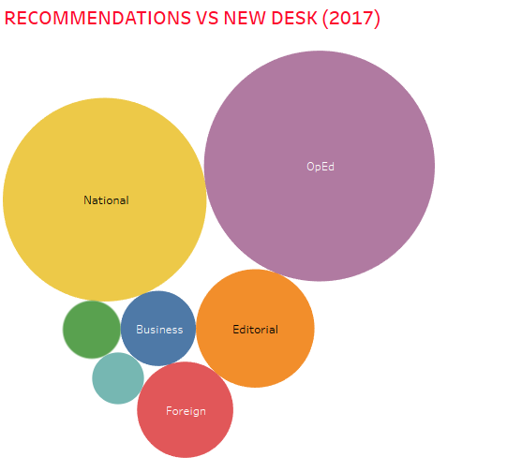
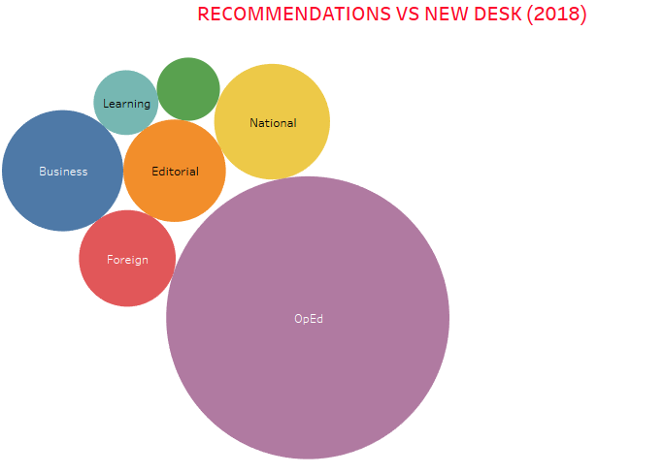
NEW DESK BASED ON RECOMMENDATIONS
Highest: OpEd
Increase in 2018: Business

Slide 15
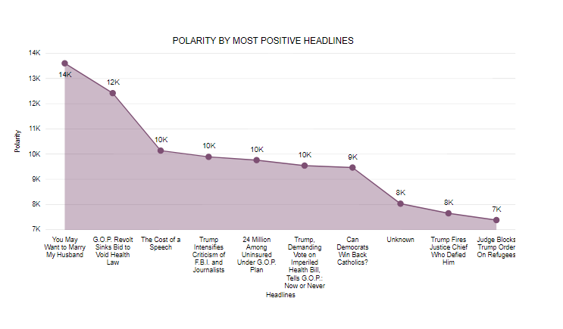
DEGREE OF POLARITY BY MOST POSITIVE HEADLINES

Slide 16
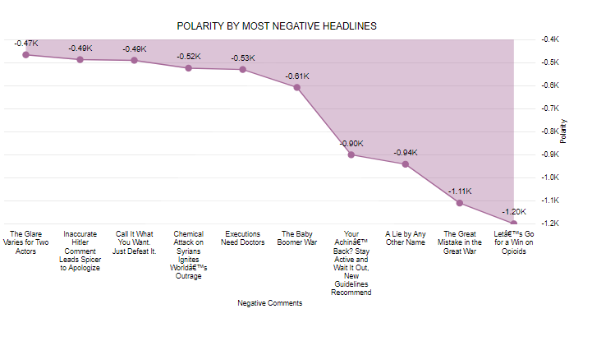
DEGREE OF POLARITY BY MOST NEGATIVE HEADLINES

Slide 17
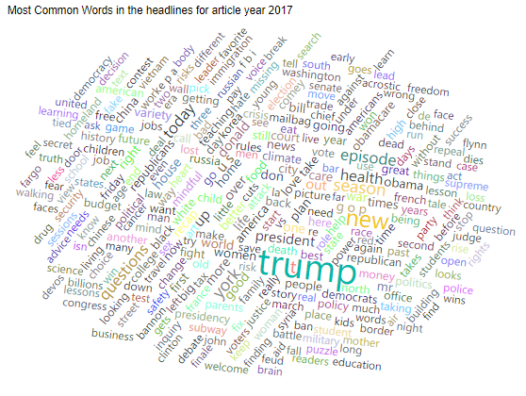
WORD CLOUD BY USER HEADLINES
Most Popular:
TRUMP

Slide 18

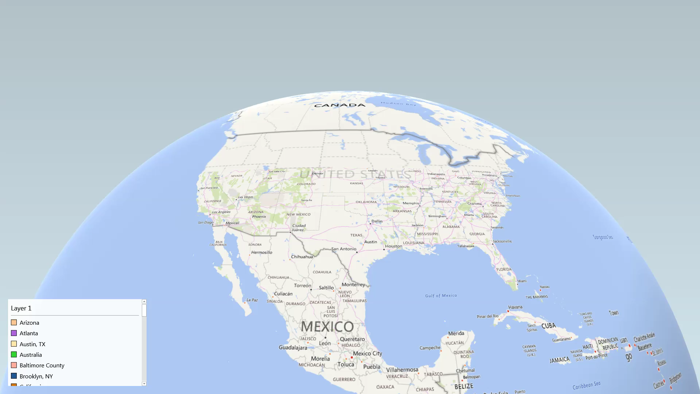
RECOMMENDATIONS BY USER LOCATION FOR 2017
NY: 27147
Cal: 15273
Chicago: 12271

Slide 19
RECOMMENDATIONS BY USER LOCATION FOR 2018
NY: 13990
Cal: 4251
Chicago: 3126

Slide 20
LIMITATIONS
We had data for just first 5 months of 2017/2018 but not of the remaining months.
So cumulative analysis of an entire year say 2017/2018 could not be performed.

Slide 21
CONCLUSION
High article Count
Highest commenters: New York
Most Talked: Trump
Sentiments

Slide 22

QUESTIONS

